Slide 1

UniProt By : Ahmed Mohamed Mahmoud Abdullah Gamal Sayed

Slide 2
In this presentation:
• Search for proteins
• How to get the most from a basic search
• Functional data in a protein entry
• Explore specific functions, locations and structural data
• Protein sequences and sequence features
• Accessing protein sequences
• Sequence analysis tools
• BLAST
• Align

Slide 3
UniProt
Created at the department of medical biochemistry of the university of Geneva and works in collaboration with the European molecular biology laboratory (EMBL), since 1987.
It is now an equal partnership between the EMBL and the Swiss Institute of bioinformatics.
A comprehensive, high-quality, and freely accessible resource of protein sequence and functional information:
Physiological protein function including subcellular location, pathways, and reactions.
Structural information including topology and access to 3D structures
Data analysis tools such as BLAST and sequence alignment

Slide 4
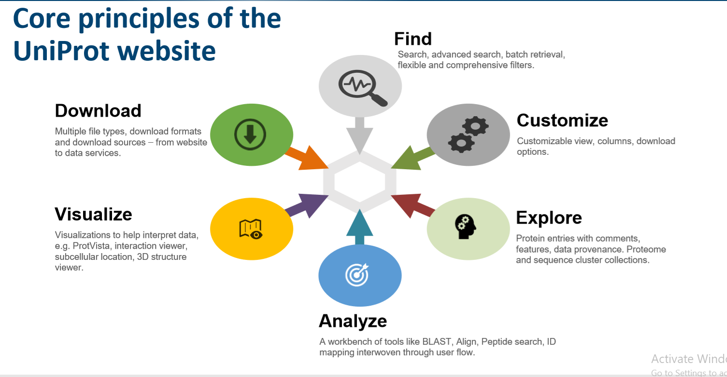

Slide 5
How To Use UniProt
1

Slide 6
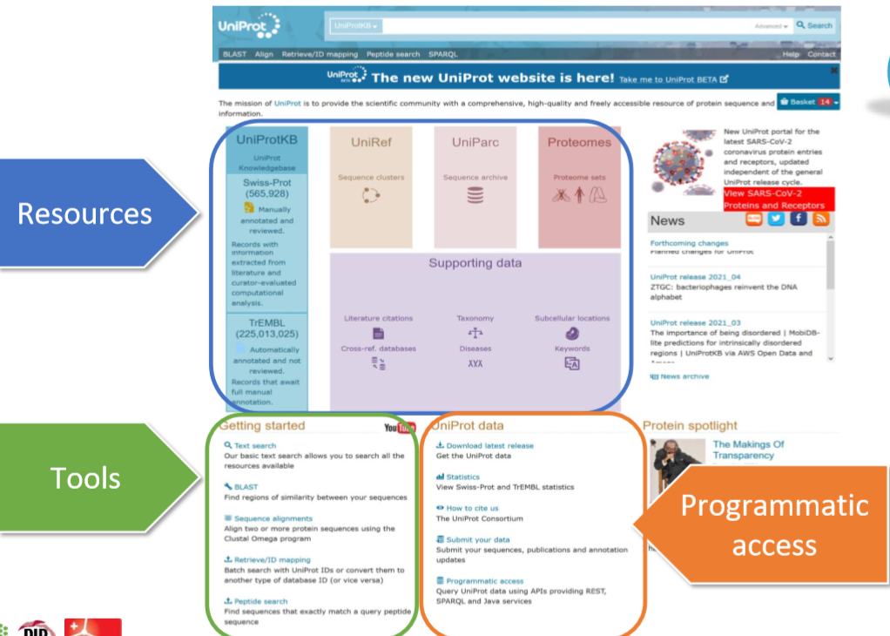
Snapshot for the home page of the UniProt

Slide 7
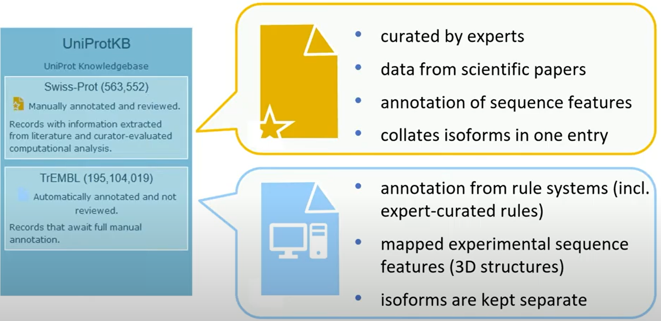
UniProt is divided into two sections

Slide 8
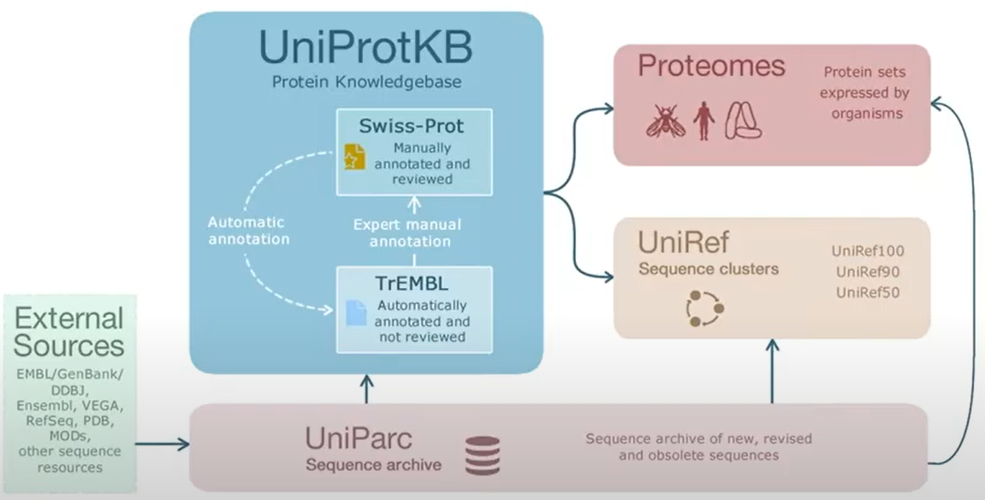
Sequence data are organized into resources
UniProt:
It is the central axis and contains, in addition to the sequence, functional and structure information.
Proteomes:
Proteomes are used to refer to a group of proteins that are expressed in a cell under certain conditions.
UniParc:
It is an archive of outdated proteins.
UniRef:
Here clusters are created between sequences based on their similarity.

Slide 9
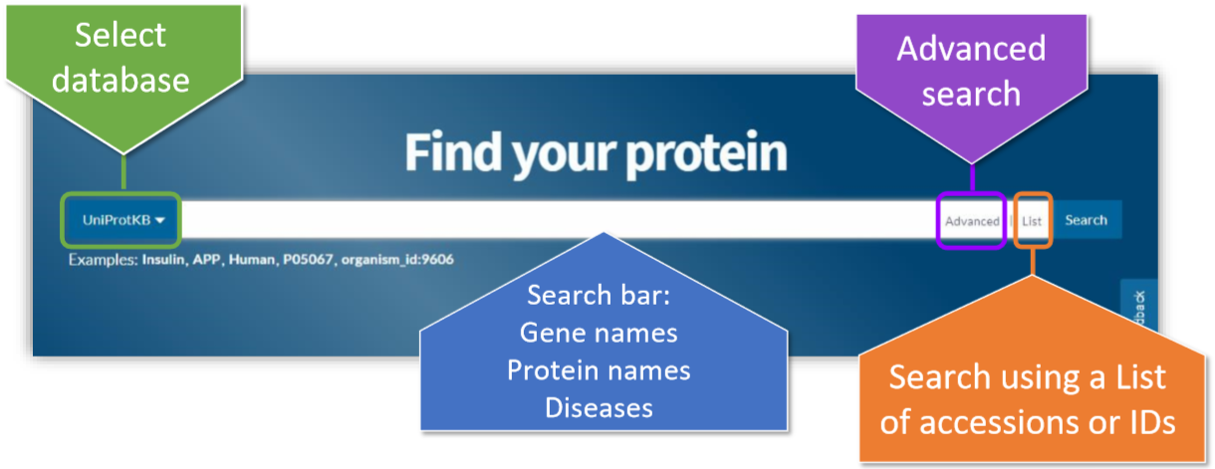
New Search Bar
Notes:
Search Bar

Slide 10
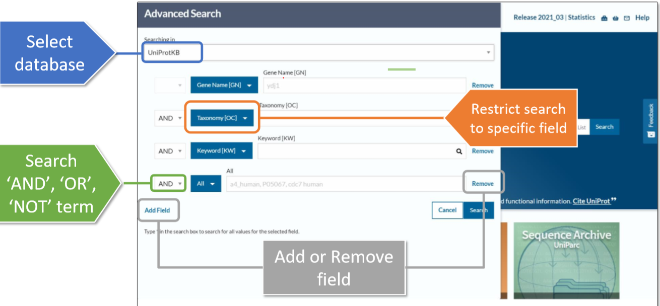
Advanced search
Notes:
Advanced search

Slide 11
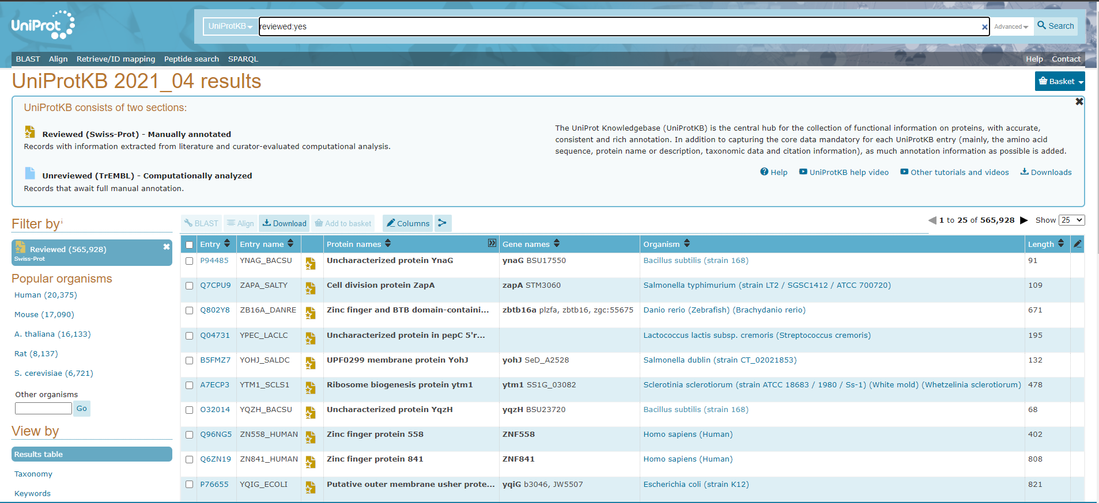
Search results

Slide 12
Reviewed Vs. Unreviewed
Protein sequence and function data is obtained from scientific publications
Protein sequences and functions are manually reviewed by expert scientists
All protein isoforms of one gene of each species are grouped together
Direct sequence submissions and sequence data from sequence repositories
Sequences and sequence data have been computationally analyzed
Protein isoforms of one gene of each species are displayed as individual entries

Slide 13
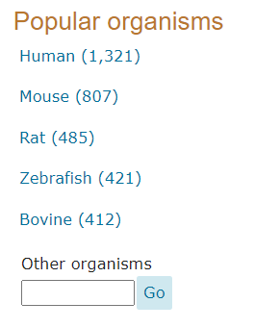
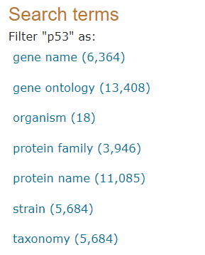
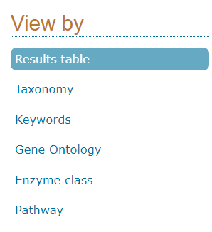
Filtering the results
Notes:
Filtering the results

Slide 14
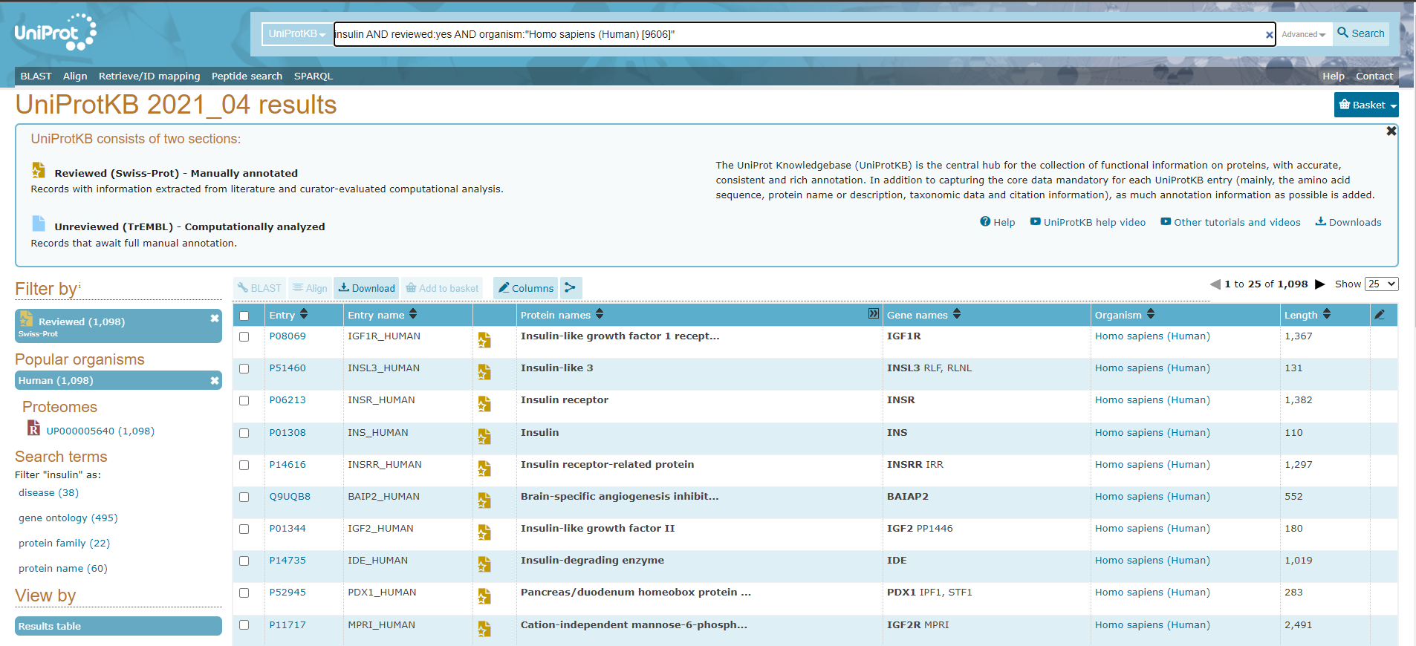
Searching For Human Insulin

Slide 15
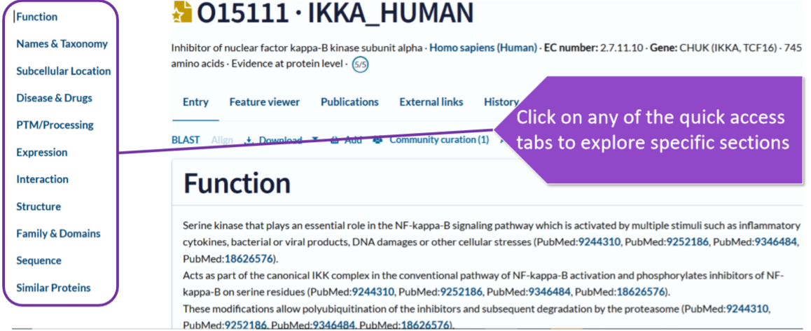
The quick access tabs
Notes:
The quick access tabs

Slide 16
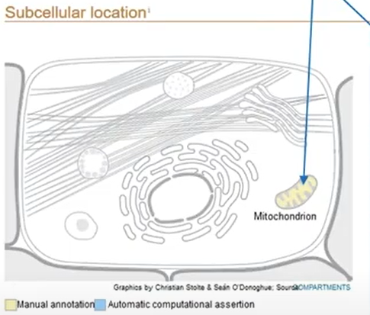
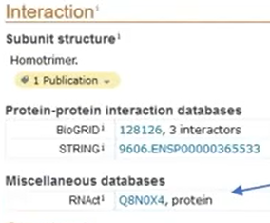
Subcellular location Interaction
The subcellular location viewer highlights where the protein is expressed in the cell
The interaction indicate any interactions that your protein may be involved in.

Slide 17
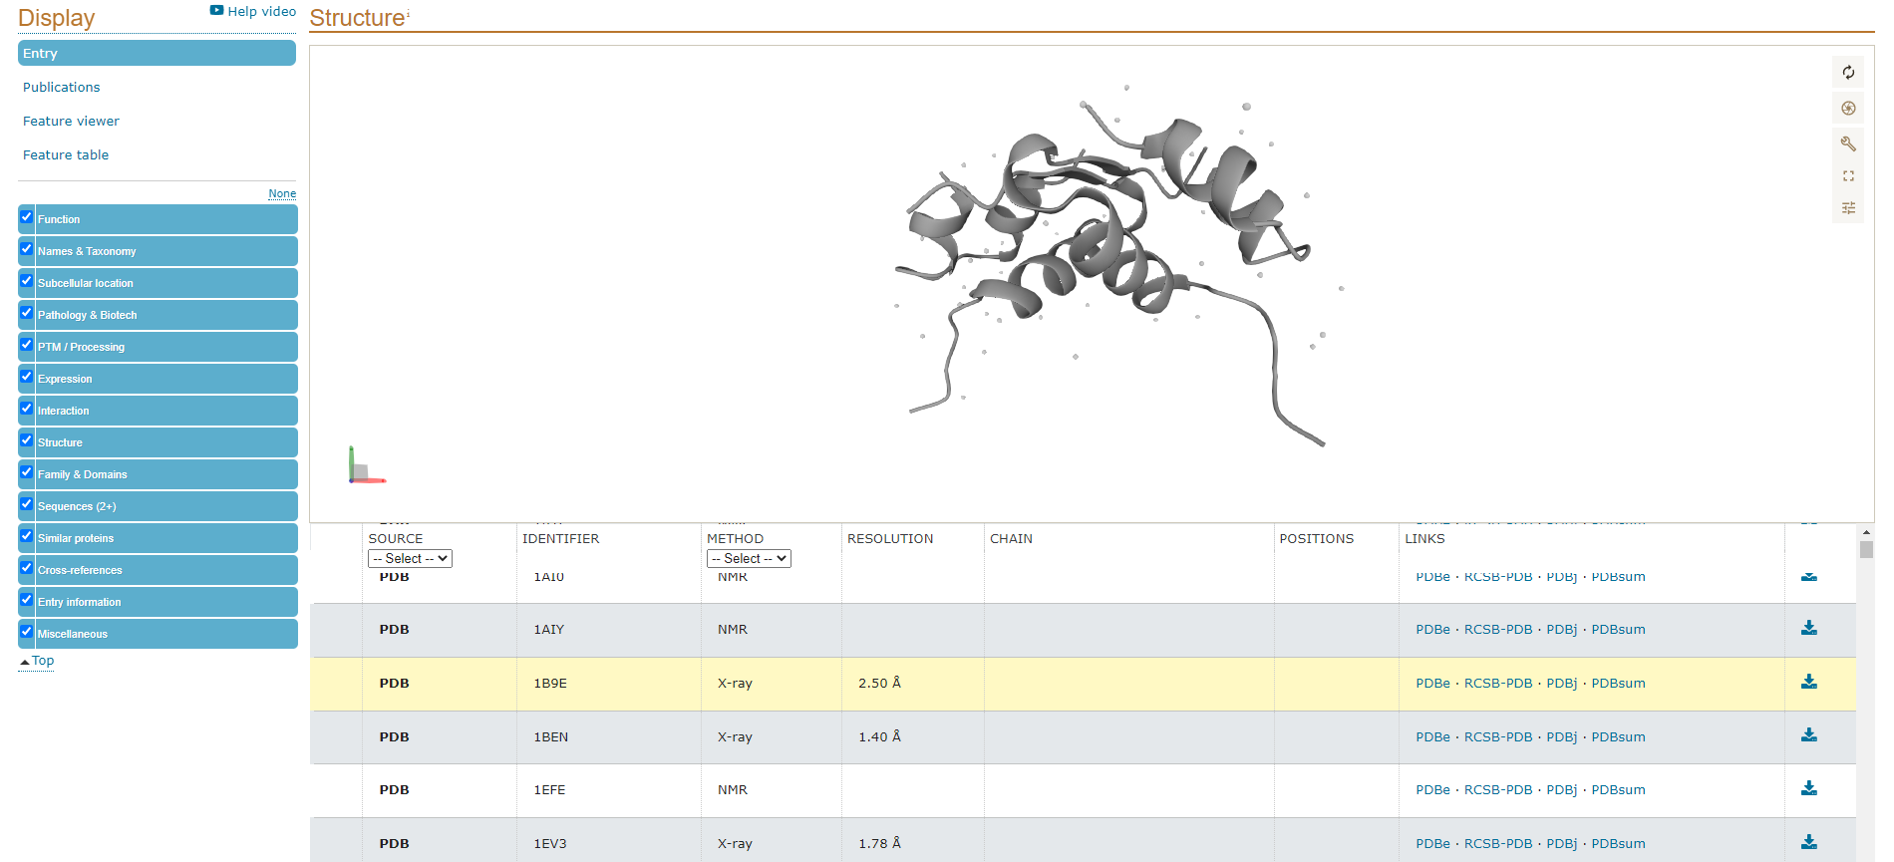
Structure of the protein

Slide 18
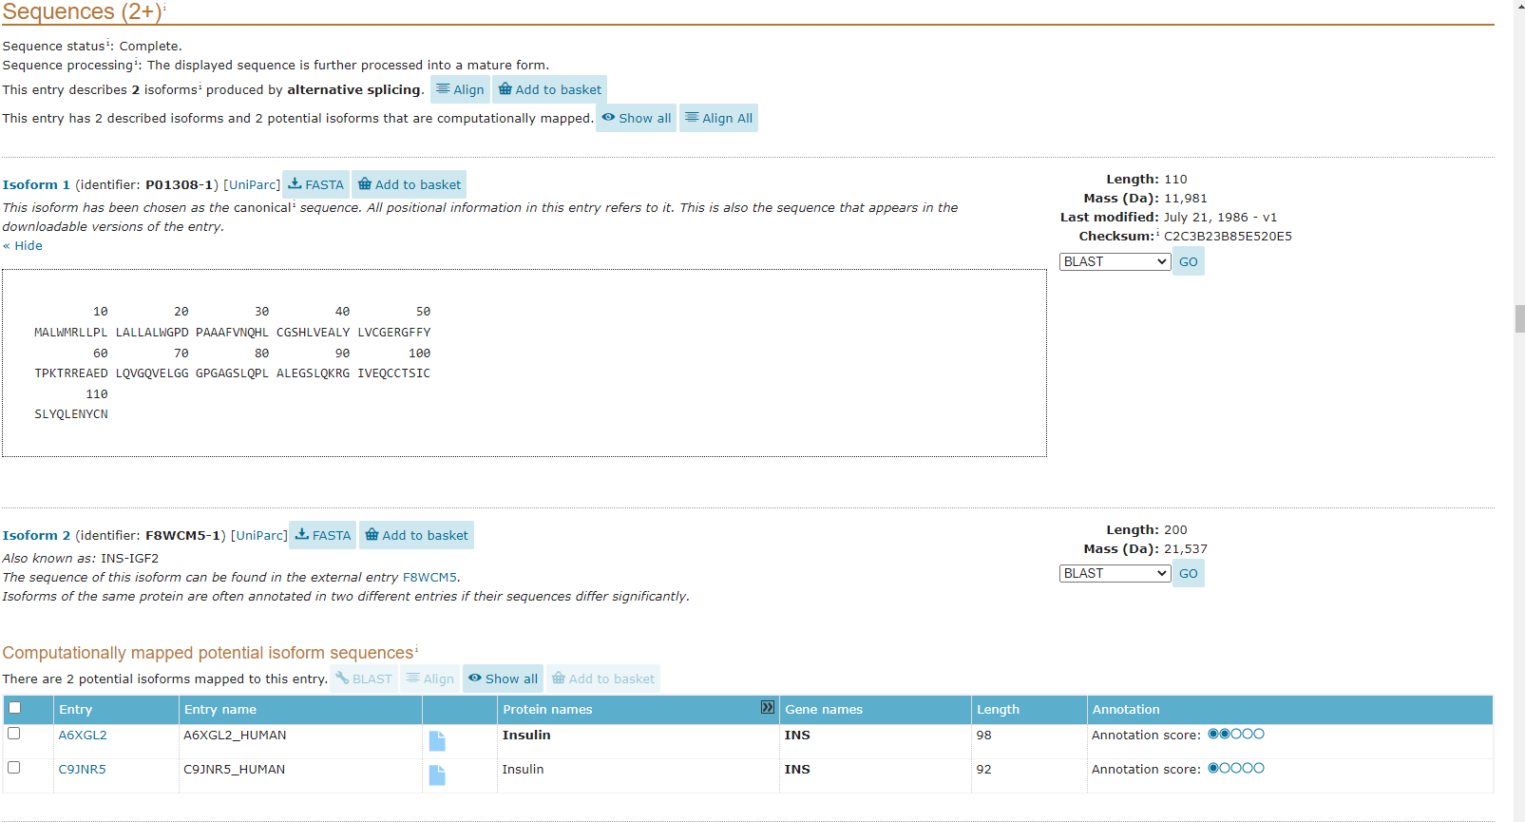
Download FASTA

Slide 19
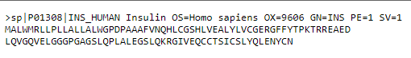
FASTA format For Human Insulin

Slide 20
Data found in FASTA file
Header File
>db|UniqueIdentifier|EntryName ProteinName OS=OrganismName OX=OrganismIdentifier [GN=GeneName ]PE=ProteinExistence SV=SequenceVersion
Protein Sequence
db is 'sp' for UniProtKB/Swiss-Prot and 'tr' for UniProtKB/TrEMBL.
UniqueIdentifier is the primary accession number of the UniProtKB entry.
EntryName is the entry name of the UniProtKB entry.
ProteinName is the recommended name of the UniProtKB entry as annotated in the RecName field. For UniProtKB/TrEMBL entries without a RecName field, the SubName field is used. In case of multiple SubNames, the first one is used. The 'precursor' attribute is excluded, 'Fragment' is included with the name if applicable.
OrganismName is the scientific name of the organism of the UniProtKB entry.
OrganismIdentifier is the unique identifier of the source organism, assigned by the NCBI.
GeneName is the first gene name of the UniProtKB entry. If there is no gene name, OrderedLocusName or ORFname, the GN field is not listed.
ProteinExistence is the numerical value describing the evidence for the existence of the protein.
SequenceVersion is the version number of the sequence.

Slide 21
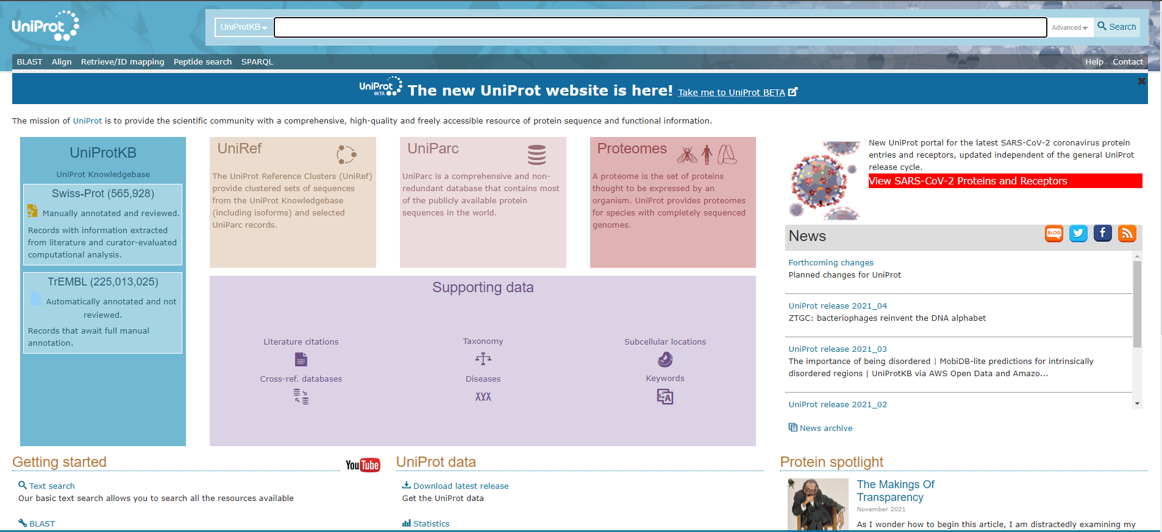
Analysis bar in UniProt

Slide 22
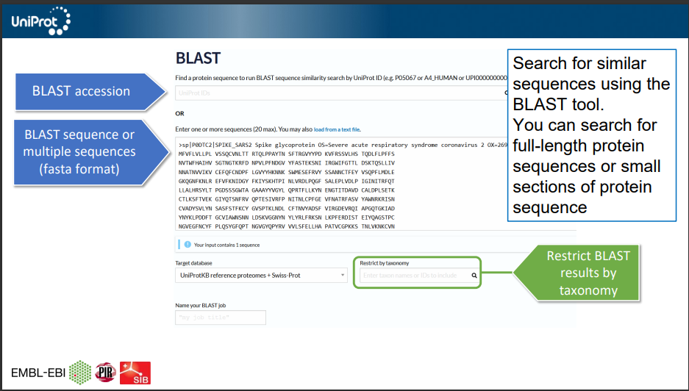
BLAST
Basic Local Alignment Search Tool

Slide 23
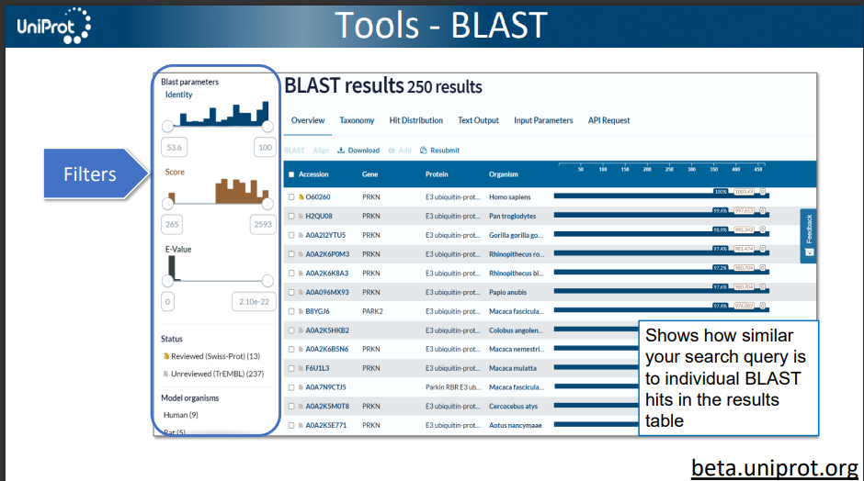

Slide 24
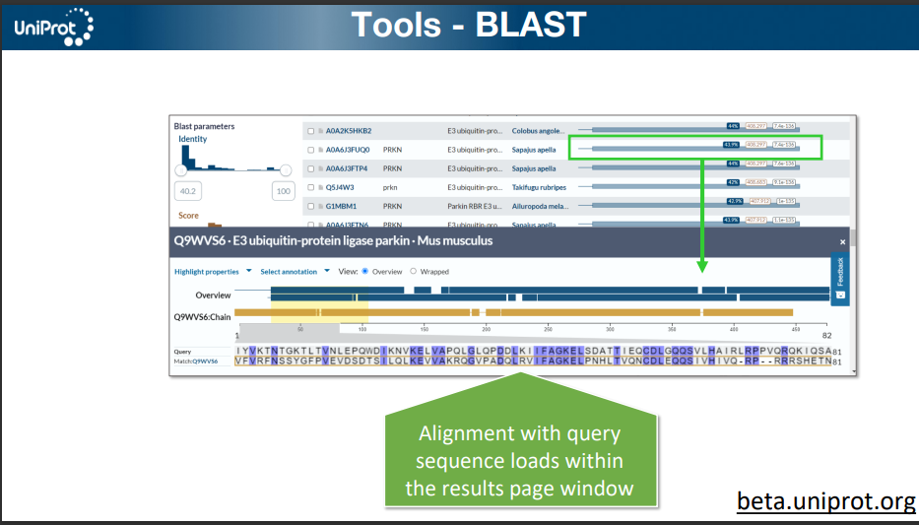

Slide 25
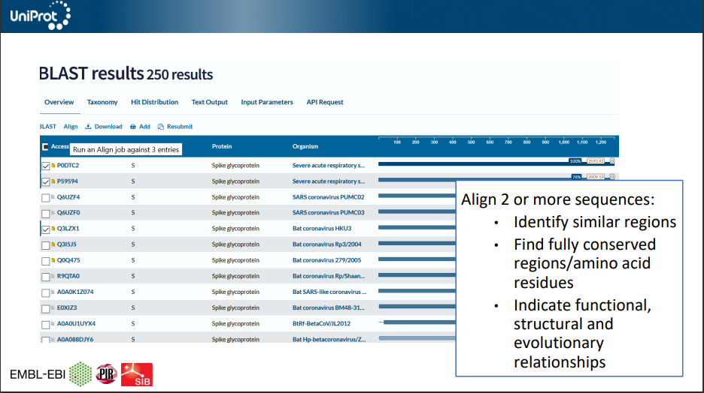

Slide 26
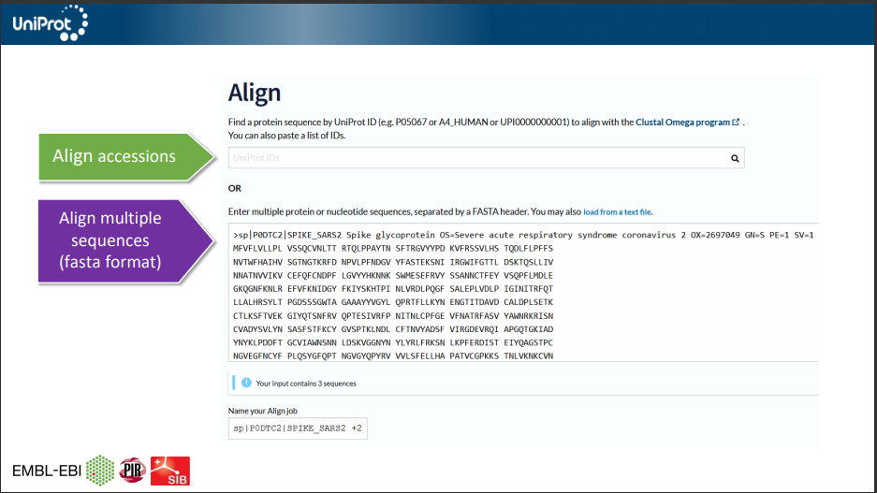
Align

Slide 27
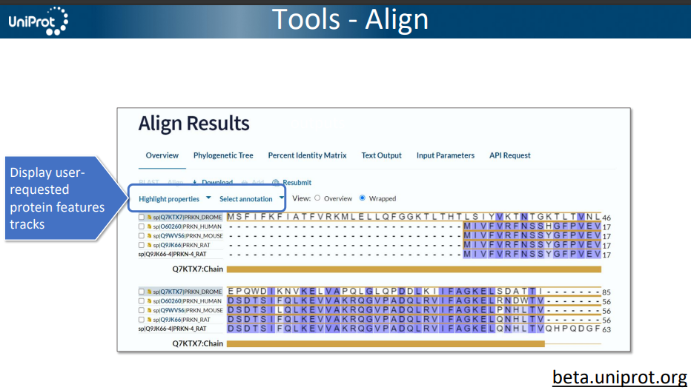

Slide 28
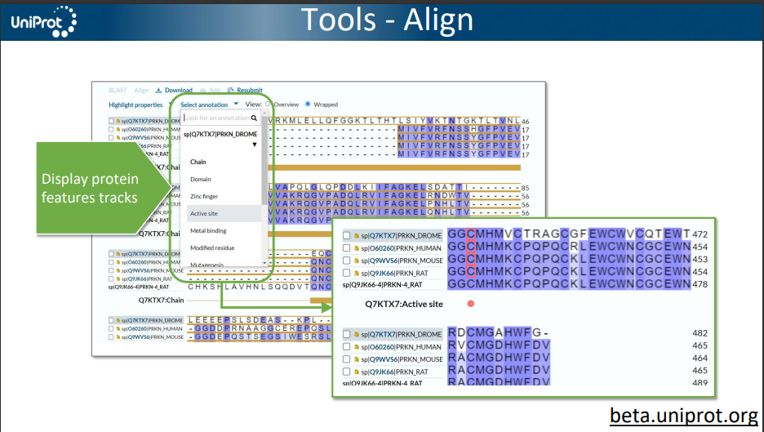

Slide 29
Thanks!
ANY QUESTIONS?
You can find me at
@username
user@mail.me

